Slide 1
Situational Leadership SLII
(People Centered Leadership)
ASQ Cleveland Section 800
March 16, 2016
Bob Graham
RLGSLG@AOL.COM
Notes:
Welcome to the Executive Overview of the SLII Experience.
Introduce yourself.

Slide 2
My Leadership Style is …..
One size doesn’t fit ALL and one size doesn’t fit ALL the time.
Notes:
Welcome to the Executive Overview of the SLII Experience.
Introduce yourself.

Slide 3

60% of our employees have smartphones
and are presumably more connected than ever before …
But few of them are satisfied with the quantity or quality of connection at work.
Notes:
Let me talk a little first about our workplaces by sharing the results of some recent Blanchard® surveys.

Slide 4
The Dysfunctionally Connected Workplace
28% of people say they rarely or never discuss their goals
64% wish they could talk to their leader about challenges with colleagues
70% say they wish they did
But only 8% do
So, more connected in some ways and
dramatically and dysfunctionally connected in other ways.
Notes:
We call this workplace the Dysfunctionally Connected Workplace.
People asked us …
Why are these statistics important?
Because connection to the leader drives organizational vitality—growth and profitability.
Let me share some of Blanchard’s research on the Leadership-Profit Chain.

Slide 5
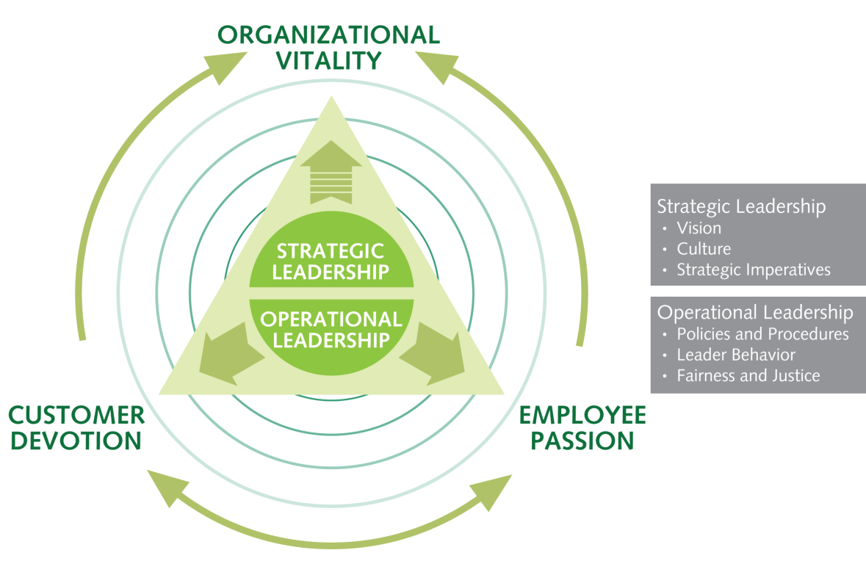
The Leadership-Profit Chain
© 2005 The Ken Blanchard Companies. All rights reserved. Do not duplicate.
Notes:
Blanchard’s research shows that organizational vitality is indirectly influenced through strategic leadership and directly impacted by employee passion and customer devotion.
Those two factors are directly influenced by operational leadership—what leaders do day in and day out as they interact with their teams.
Operational leadership is also directly linked to strategic leadership effectiveness.
But the key variable that drives long-term sustainability and organization profitability is a combination of strategic and operational leadership actions that drive employee passion and customer devotion.
Let me share just a little bit more about what this research has shown us.

Slide 6

Leadership-Profit Chain Truths
Effective strategic leadership only indirectly predicts organizational vitality.
Effective operational leadership directly predicts positive employee passion.
Positive employee passion directly predicts customer devotion.
Employee passion directly predicts organizational vitality.
Customer devotion directly predicts organizational vitality.
Truths
Notes:
Each of these statements is true.
What we want to do through the SLII Experience is improve operational leadership to drive employee work passion. We want to improve the quality and quantity of conversations between leaders and their team members. We want to build a sense of partnership and connection.
But we’ve learned that leaders often fail to engage in the behaviors that create that sense of connection. They make mistakes.

Slide 7
The Biggest Leadership Mistakes
82%
Lack of listening
Undersupervision, oversupervision,
direction, or delegation
Lack of management skills
Lack of support/inappropriate support
Lack of accountability
81%
76%
76%
59%
Mistakes
Notes:
When asked, employees also told us about the biggest mistakes leaders make. (Share stats.)
Situational Leadership® II teaches leaders how to listen. It teaches them how to provide the right leadership style—not too much or too little leadership, but just the right amount. It builds their leadership skills and teaches them how to support less experienced and more experienced team members. It helps them create alignment on goals and clear accountability for both the team member and leader so that those goals are accomplished.

Slide 8
Top Five Things Leaders Fail to Do
82%
Fail to provide feedback
(recognition or redirection)
Fail to listen or involve
Fail to use the right leadership style
(oversupervise or undersupervise)
Fail to set clear goals
Fail to develop others
81%
76%
76%
59%
Fail to Do
Notes:
When asked, employees also told us about the five things that leaders fail to do. (Share stats.)
Situational Leadership® II helps leaders develop others’ competence and commitment by providing the right leadership style—personalized to the person and the task at the right time. It teaches them how to set goals, involve, support, and provide feedback.
And the payback is …

Slide 9

The Power of Leadership
Organizations that have excellent leaders grow at a rate of 10 times faster
than those that do not.
Notes:
Leadership is an enabler of strategic growth.
A10-year study conducted by Warren Bennis and USC showed that organizations with excellent leaders grow at a rate of 10 times faster than those that do not.
Other research at Bassi and Harvard confirm this. Organizations with exemplary leaders outperform organizations with average leaders.
So what is SLII®?

Slide 10
Formal and Informal Leadership
Situational Leadership Can be Utilized:
By Formal Leaders
  Direct Reporting Relationship
Informal Leaders
Peer-to Peer
Applicable to Teams
Notes:
When asked, employees also told us about the five things that leaders fail to do. (Share stats.)
Situational Leadership® II helps leaders develop others’ competence and commitment by providing the right leadership style—personalized to the person and the task at the right time. It teaches them how to set goals, involve, support, and provide feedback.
And the payback is …

Slide 11
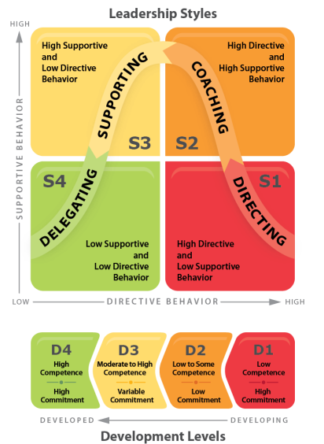
Situational Leadership® II
The World’s Most Widely Used Leadership Development Model
Notes:
SLII is the most widely used leadership development model in the world today.
Some of the best organizations in the world rely on Situational Leadership® II because it works! (List relevant clients.)
This executive overview is a preview of our newest rerelease of our flagship leadership development program, Situational Leadership® II, the SLII Experience.
We’re calling it the SLII Experience to emphasize that learning is not a one-time event, but an experience that happens over time. This is a game-changing way to teach SLII, leveraging all of the theory and design that has made SLII the most-taught leadership model in the world for more than 30 years.
The SLII Experience uses engaging, innovative learning techniques that immerse learners in SLII quickly, deeply, and effectively. It is the same proven content and concepts you already know, completely reimagined in the SLII Experience.
So what are your organization’s needs?
11

Slide 12
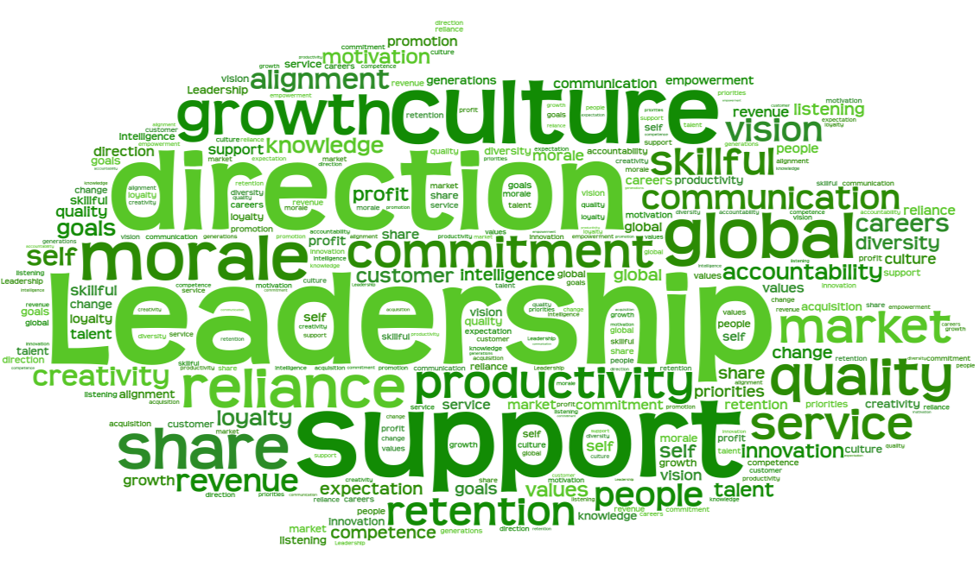
What are your needs?
Which involve PEOPLE?
Notes:
Let’s talk a little about your needs and how Situational Leadership® II can help you address them.
Of course all of your needs involve people. People who can excel or undermine. People who give discretionary effort or who do the minimum. People who stay and continue to contribute or who leave. People who endorse the organization to others or who don’t speak positively about where they work. People who are good corporate citizens or who aren’t.
The research we’ve done at Blanchard proves that SLII significantly impacts employee retention, employee engagement, customer satisfaction, growth in terms of revenue and margin, promotability, bench strength, and leadership skills. It helps leaders and their team members make significant contributions to the bottom line through their creativity and competence.
We have the impact studies to show the results companies have been able to claim as a result of SLII training.
Let’s look a little more closely at the competencies leaders will develop through the SLII Experience.

Slide 13

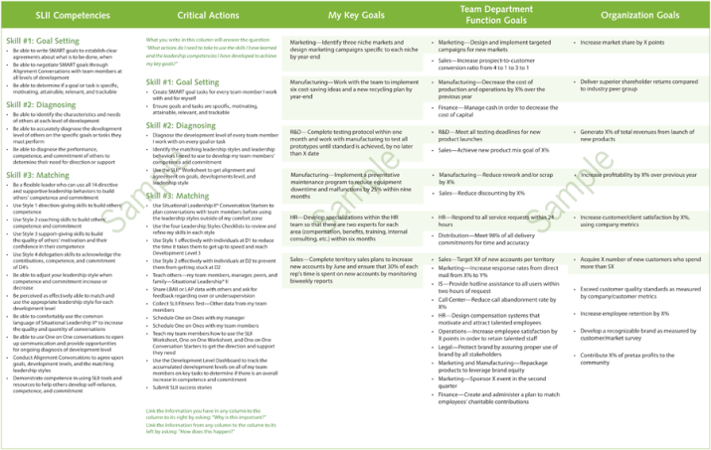
Components We Will Cover Included in the SLII Experience :
Skill 1—Goal Setting
  Be able to write SMART goals to establish clear agreements about what is to be done, when
  Be able to negotiate SMART goals and perform task assignment through Alignment Conversations with team members at all levels of development
  (NOTE: M in SLII SMART GOALS stands for Motivating)
Notes:
How would mastering these competencies impact your talent strategy?

Slide 14
Introduce …
Skill 2—Diagnosing
  Be able to identify the characteristics and needs of others at each level of development
  Be able to accurately diagnose the development level of others on the specific goal or tasks they must perform
Notes:
How would mastering these competencies impact your talent strategy?—continued

Slide 15
Introduce SLII
Leaders …
Skill 3—Matching
  Introduce explanantion of flexible leaders who can use all 14 directive and supportive leadership behaviors to build others’ competence and commitment
  Be able to adjust their leadership style when competence and commitment increases or decreases for a specific Task or Goal
Notes:
How would mastering these competencies impact your talent strategy?—continued

Slide 16
SLII Leaders will …
Skill 3—Matching
  Introduce One on One Conversations to open up communication and provide opportunities for ongoing diagnosis of development level
  Introduce Alignment Conversations to agree on goals, development levels, and the matching leadership styles
  Demonstrate competence in using SLII tools and resources to help others develop self-reliance, competence, and commitment
Notes:
How would mastering these competencies impact your talent strategy?—continued
How do we teach these competencies? How do we teach leaders this credible, practical, compelling, and inspiring framework for leading others?

Slide 17
PRACTICE
LEARN
Situational
Leadership® II
MASTER
LAUNCH
The SLII Experience Road Map to Success
Notes:
The SLII Experience uses a four-phase learning process. (Name the four phases.)

Slide 18


Goal Setting or Task assignment
Aligning on what
needs to be done, when
Diagnosing
Collaboratively assessing
an individual’s competence and commitment on a specific goal or task
Alignment
Matching
Using a variety
of leadership styles, comfortably,
to provide individuals with what they need
Three Skills of a Situational Leader
Notes:
The three skills of a Situational Leader are Goal Setting, Diagnosing, and Matching, which drives alignment and ultimately goal accomplishment.
Let me preview what’s taught in Goal Setting.

Slide 19
Goal Setting or Task Assignment
the first skill of a situational leader
Notes:
Goal Setting is the first skill of a Situational Leader.
We teach SMART goals, but our approach to SMART is a little different than what you might be used to.

Slide 20
Goal Setting
the first skill of a situational leader
Specific
  What exactly is the goal or task? What does a good job look like?
+

Slide 21
Goal Setting
the first skill of a situational leader
Specific
  What exactly is the goal or task? What does a good job look like?
Trackable
  Is there a way to track progress? Are there measures?
+

Slide 22
Goal Setting
the first skill of a situational leader
Specific
  What exactly is the goal or task? What does a good job look like?
Relevant
  Is the goal important and aligned with organization goals?
Trackable
  Is there a way to track progress? Are there measures?
+

Slide 23
Goal Setting
the first skill of a situational leader
Specific
  What exactly is the goal or task? What does a good job look like?
Attainable
  Is the goal realistic and achievable?
Relevant
  Is the goal important and aligned with organization goals?
Trackable
  Is there a way to track progress? Are there measures?
+

Slide 24
Goal Setting
the first skill of a situational leader
Specific
  What exactly is the goal or task? What does a good job look like?
Motivating
  Am I excited and interested in this goal?
Attainable
  Is the goal realistic and achievable?
Relevant
  Is the goal important and aligned with organization goals?
Trackable
  Is there a way to track progress? Are there measures?
+

Slide 25
Diagnosing
the second skill of a situational leader
Notes:
Diagnosing is the second skill of a Situational Leader.

Slide 26
Diagnosing Development Level
the second skill of a situational leader
Diagnosing
Collaboratively assessing an individual’s competence and commitment on
a specific goal or task
Competence
Commitment
Your demonstrated goal- or task-specific, transferable knowledge and skills
Your motivation and confidence on a specific goal or task
Development Level is a combination
of two factors.
Notes:
You diagnose competence and commitment.
Let’s look at a couple of examples.

Slide 27
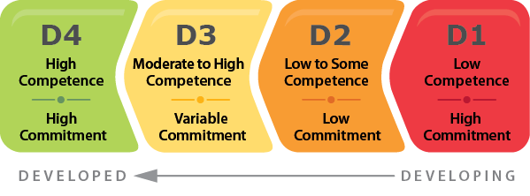
Development Levels
Development level is goal or task specific!
+

Slide 34
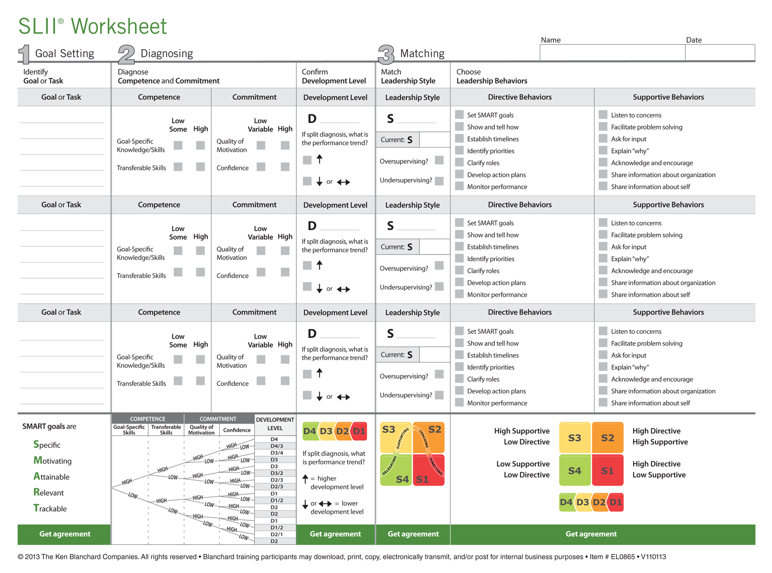
✓
✓
✓
✓
Notes:
Let me show you how the SLII Worksheet works. After the SLII Experience, leaders and their team members have access to this worksheet. It is interactive. It can be downloaded, shared, and emailed as often as desired.
Let me show you how a diagnosis is done.
34

Slide 35
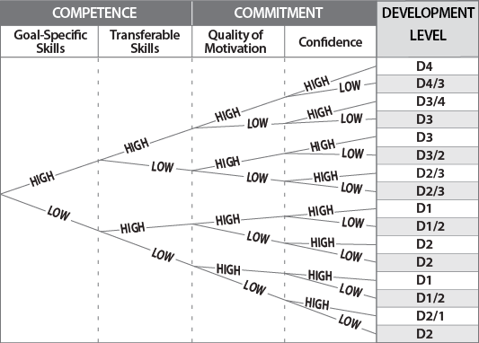
Diagnosing Development Level
Diagnosis Chart
Notes:
Once a diagnosis is made, leaders are taught how to address the needs of someone at that level of development.

Slide 36




Practice Diagnosing
Nicholas is a new and highly motivated sales representative. He recently compiled his first top 20 list of qualified buyers, but he doesn’t know how to distinguish between a good prospect and a bad one. He is eager to rectify the situation and learn all there is to know.
What is the task or goal?
LOW/SOME
HIGH
Task Competence
Task Commitment
LOW/VARIABLE
HIGH
Development Level
Notes:
To diagnose, you ask three questions:
What is the goal?
What is the person’s competence?
What is the person’s commitment?
36

Slide 37
Practice Diagnosing
Kate, an experienced marketing director, is feeling a bit ill. She has been up for three nights straight, working on the usual quarterly executive report. Feedback on her presentations has always been positive because she does an excellent job. Even though she is always successful, she agonizes over these presentations, seeing her reputation on the line each time she presents.
What is the task or goal?
LOW/SOME
HIGH
Task Competence
Task Commitment
LOW/VARIABLE
HIGH
Development Level
Notes:
To diagnose, you ask three questions:
What is the goal?
What is the person’s competence?
What is the person’s commitment?
37

Slide 38
Three Skills
Goal Setting or Task Assignment
(What do we need
people to do?)
Diagnosis
(Where are they in terms of competence and commitment at being able to do that?)
Matching
(Give people what they need in terms of direction and support to be able to succeed on those goals and tasks.)
Notes:
Once you diagnose, you need to provide the right amount of direction and support to address the person’s needs.
That’s the third skill of a Situational Leader.
38

Slide 39
Matching
the third skill of a situational leader
Notes:
What does a match look like?

Slide 40
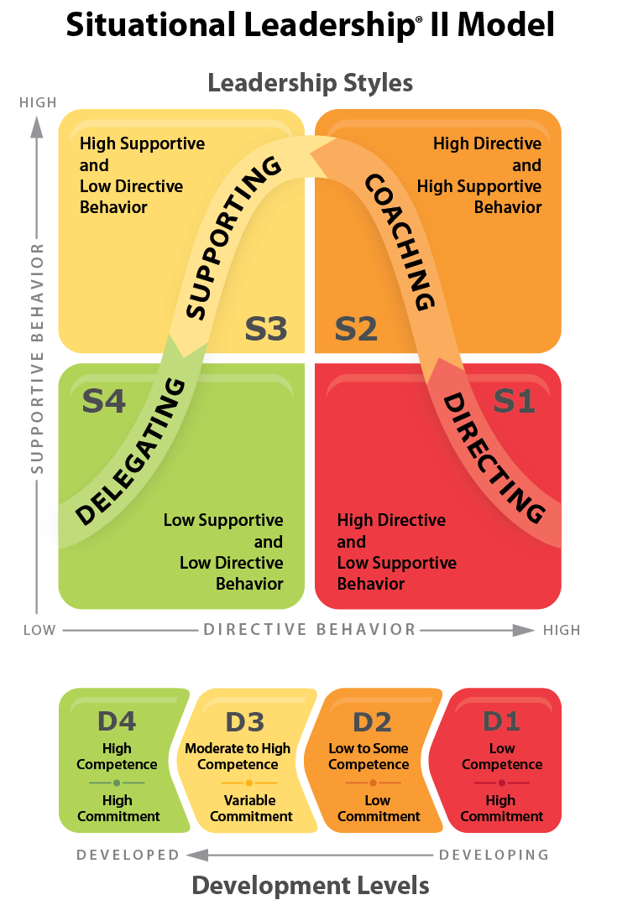
Intention
Build confidence in competence
Intention
Re-energize and reteach
Intention
Value Contribution
Intention
Help others build competence
Notes:
For people at D1, you want to help them build their competence, so you use Style 1, which is high on direction and low on support.
For people at D2, you want to help them build their competence and commitment, so you use Style 2, which is high on both direction and support. You want to re-energize and reteach them.
For people at D3, you want to build their confidence in their competence. They know how to do the goal or task at hand but are insecure and second-guessing themselves. So you use Style 3, which is high on support but low on direction.
With people at D4 you want to use low direction and support, Style 4, so that you value their contribution.
40

Slide 41

Practice Matching
Nicholas is a new and highly motivated sales representative. He recently compiled his first top 20 list of qualified buyers, but he doesn’t know how to distinguish between a good prospect and a bad one. He is eager to rectify the situation and learn all there is to know.
What is the task or goal?
Learn how to identify a good prospect in order to spend his
time wisely to build sales
LOW/SOME
LOW
Task Competence
Task Commitment
LOW/VARIABLE
HIGH
✓
Development Level
Matching: What leadership style does Nicholas need to progress on this goal?
Notes:
Practice matching.
Ask three questions:
What is the goal?
What is the person’s competence?
What is their commitment?
Then, determine the matching leadership style.

Slide 42

Why Match?
Before SLII training
54% of managers
use one style naturally
1% use
all four styles naturally
11% use
three styles
naturally
34% use
two styles naturally
Notes:
Why match? Because most leaders are inflexible.

Slide 43
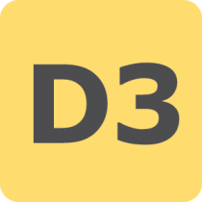


Why Match?
Self-Reliant Achiever
Capable, but Cautious, Performer
Disillusioned Learner
Enthusiastic Beginner
15%
50%
25%
10%
Critical Task Distribution
Notes:
Why match? Because most managers need to be able to work with team members at all four levels of development.
This development level distribution is obviously not ideal, with only 15% of critical tasks being performed at the D4 level.

Slide 44
With Effective Leadership,
What Economics Are Possible?
X
(+)
X
NET ECONOMIC CONTRIBUTION
D4
D3
D2
D1
0
X
X
(-)
Development Levels
Notes:
So what? Why does it matter that 35% of critical tasks are performed at beginner (D1) or learner (D2) levels? People performing at these development levels are returning a negative net return to the bottom line.
Why does it matter that another 50% of critical tasks are performed at Capable, but Cautious, Performer (D3) levels?
People performing at Development Level 3 are returning significantly less net return to the bottom line than a Self-Reliant Achiever (D4) on the same task (exact return depends on the task being performed).
For example, consider the relative economic return of your top salespeople versus your average salespeople; typically, the 80/20 rule applies (i.e., 80% of the economic return is produced by 20% of the people).
So we can’t just teach your leaders the concepts of SLII, they have to practice with the skills of a Situational Leader so it become second nature.

Slide 45
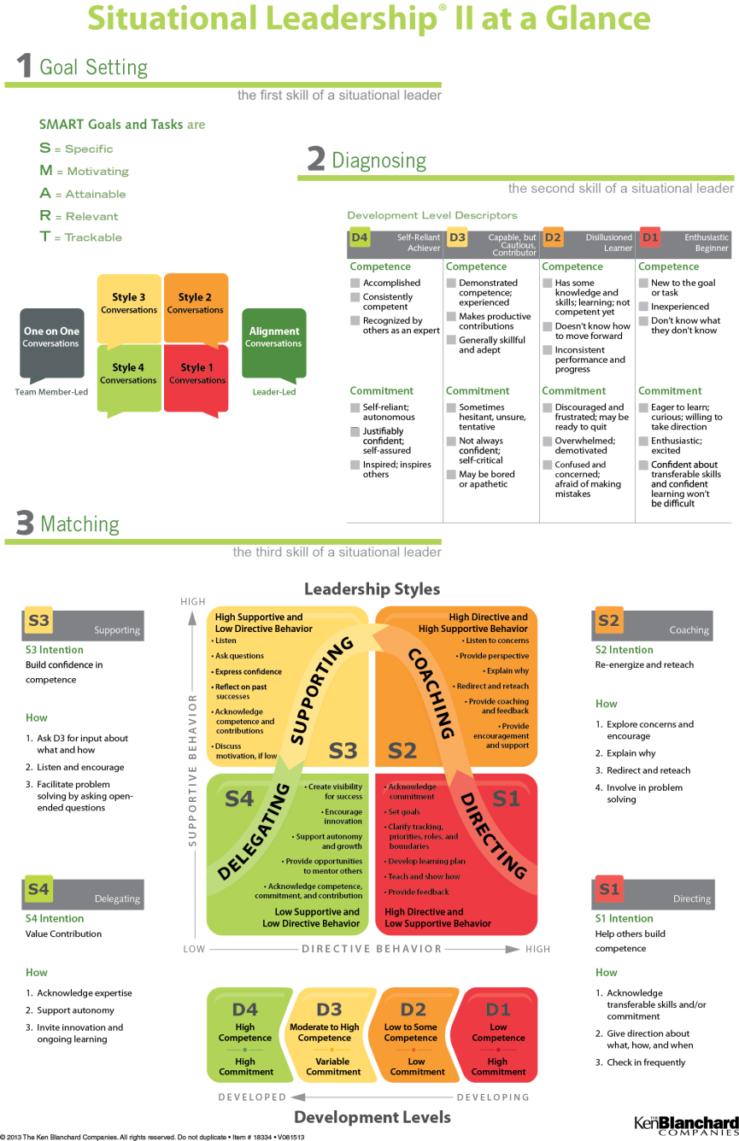

Matching
takes
Practice …

Slide 46

Have you ever been
oversupervised?
undersupervised?
What is the IMPACT?
Notes:
Ask the questions on the slide.

Slide 47
Match versus Mismatch
The goal is a
MATCH
Two types of
MISMATCH
S1
S2
S3
S4
D1
D2
D3
D4
Oversupervision
S1/S2 with D3/D4
Undersupervision
S3/S4 with D1/D2
Over time, with a match,
individuals learn to provide
their own
direction and support.
3 Choices: Match, Oversupervise, or Undersupervise
Notes:
A leader can either match his or her leadership style to the team member’s need(s) for direction or support, building the person’s competence and commitment, or the leader can mismatch, which occurs when the leader provides too much direction or too little direction or support.
There are two types of mismatch:
Oversupervision—Using S1/S2 with D3/D4
Undersupervision—Using S3/S4 with D1/D2

Slide 48
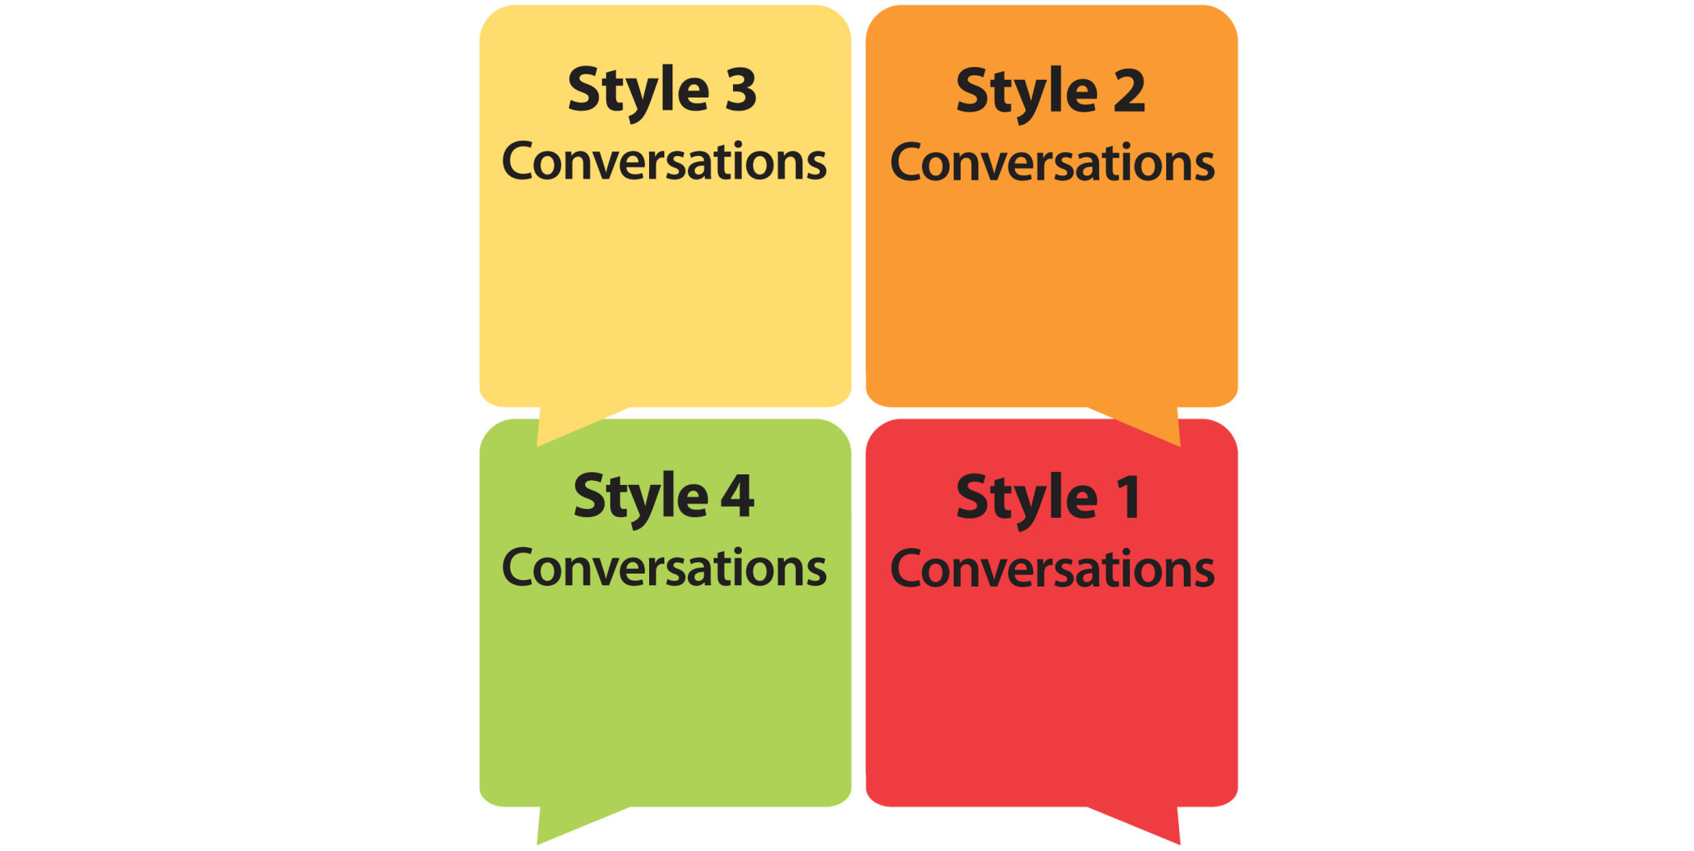
Four SLII Style Conversations
How
Ask D3 for input about what and how
Listen and encourage
Facilitate problem solving by asking open-ended questions
How
Explore concerns and encourage
Explain why
Redirect and reteach
Involve in problem solving
How
Acknowledge expertise
Support autonomy
Invite innovation and ongoing learning
How
Acknowledge transferable skills
and/or commitment
Give direction about what, how, and when
Check in frequently
Notes:
You match by having the right conversation. In PRACTICE, we teach leaders how to do a Style 1, 2, 3, and 4.

Slide 49

How many of you would like your team members or Leaders coming to you asking for the leadership style response you/they need?
Notes:
Post the question on the slide.

Slide 50

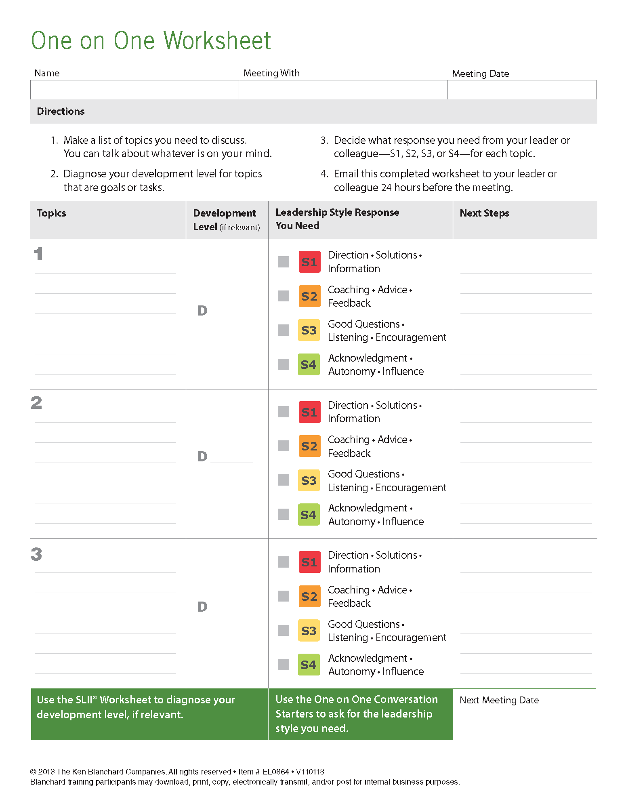
YOU (Employee) decide what to talk about and the leadership style response you need
Short—15 to 30 minutes
Preferably prescheduled; sometimes impromptu
Often tagged onto another meeting
What is a One on One Conversation?
Notes:
(Discuss One on Ones — the rules and the worksheet. )
But we can’t stop there—we have to support managers in using SLII on the job. That’s the fourth phase: MASTER.
.

Slide 51
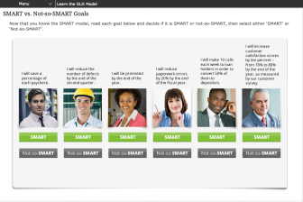
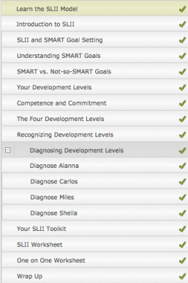
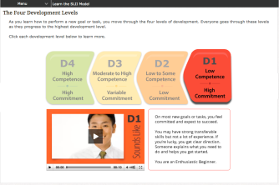
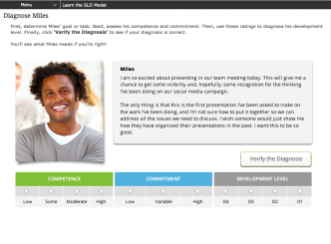
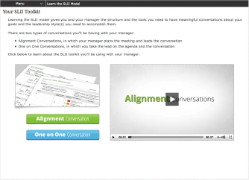
Learn the SLII Model Online
Notes:
We also want team members to learn the language of SLII, so we created an online learning asset. (Demonstrate it, if possible.) For one price a leader and up to 20 team members have access to this resource for a year.

Slide 52
More Information:
http://www.kenblanchard.com/

Slide 53
Questions?
Notes:
Solicit and answer any questions.

